Slide 1


MALAYSIA’S REQUIREMENTS ON INDUSTRIAL EFFLUENT TREATMENT SYSTEMS
-The WEPA Workshop and Annual Meeting 18-21 February 2013
Siem Reap, Combodia-
by
eNFORCEMENT DIVISION
DEPARTMENT OF ENVIRONMENT, MALAYSIA
Scope of Presentation
Introduction
Regulation Requirements
Control Based on Engineering Design of IETS Performance Monitoring of IETS Contravention Licence

Slide 2
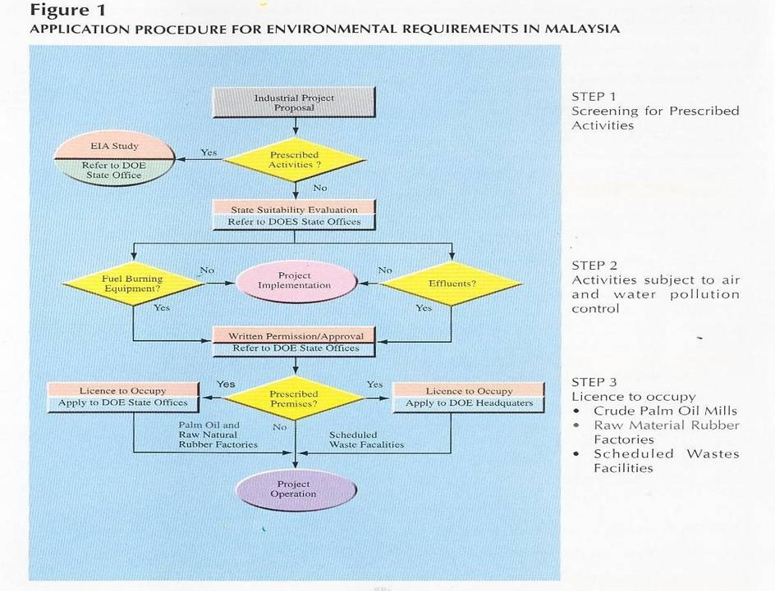
Written Notification
Introduction
Industrial Effluent Treatment Systems:
any facility including the effluent collection system, designed and constructed for the purpose of reducing the potential of the industrial effluent or mixed effluent to cause pollution.
“industrial effluent” means any waste in the form of liquid or wastewater generated from manufacturing process including the treatment of water for water supply or any activity occurring at any industrial premises;
4

Slide 3
INDUSTRIAL EFFLUENT TREATMENT SYSTEMS (IETS)
Section 4 in Industrial Effluent Regulation, 2009 (IE2009)*- a premise is required to notify DOE for:
New sources
Increase in production capacity resulting in increase in effluent quantity
IETS upgrading resulting in worsened effluent quality
*[written notification requirement to replaces the written permission in SIER1979]
System (IETS)
Section 5 and Section 6: Specification on IETS
-Design and Operation-
Needs to comply with the Guidance Document on Design and Operation (GDDO);
Undertaken by professional engineers;
IETS must comply with stipulated operational characteristics
6

Slide 4
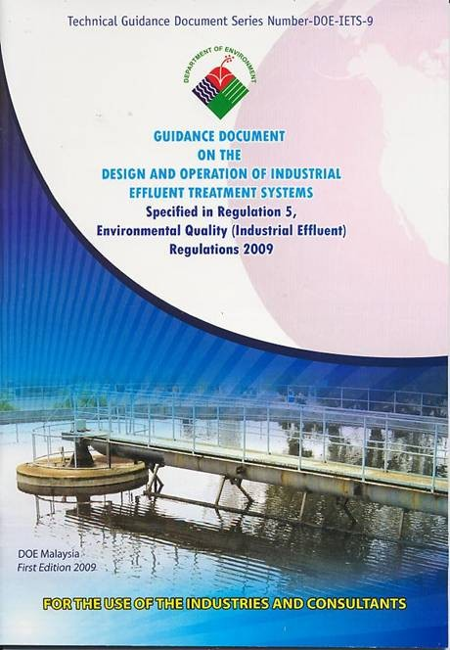
Written Declaration on Design and Construction of IETS
(NEW and ALTERED SOURCES OF EFFLUENT DISCHARGE)
-Declare that the industrial effluent treatment system has been designed and constructed in strict compliance with the minimum requirements and specifications as specified in the Guidance Document by:
•Owner
•Engineer responsible for the treatment design process
•Engineer responsible for the structural design
•Engineer responsible for the design of mechanical components
•Engineer responsible for the design of mechanical and electronic components

Slide 5
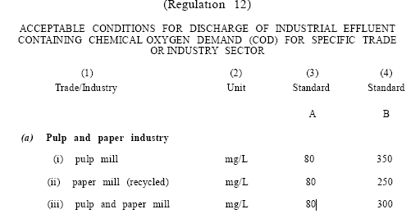
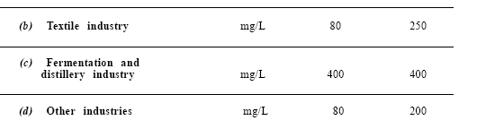
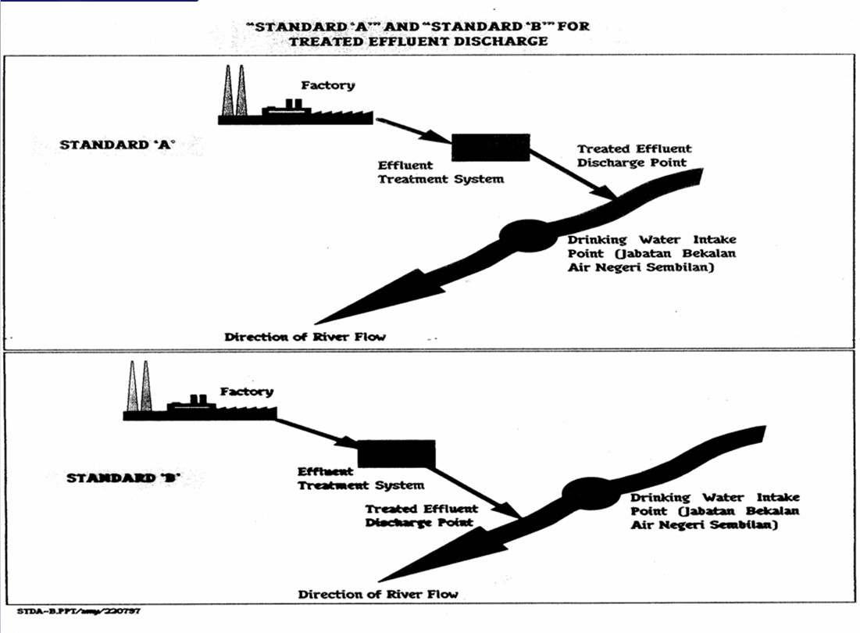

Slide 6
Control Based on Engineering Design of IETS
Engineering Design of IETS
Common Industrial Effluent Treatment System used in industries in Malaysia
1. Physcio-Chemical Treatment Processes
Chemical Precipitation
Oxidation/reduction
Dissolved Air Floatation (DAF)
2. Biological Treatment Processes
☺ Activated Sludge
☺ Sequential Batch Reactor
☺ Oxidation Ponds
☺ Trickling filters
☺ Anaerobic Upflow Sludge Blanket (AUSB)
12

Slide 7
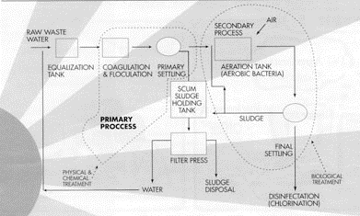
Engineering Design of IETS
Common Industrial Effluent Treatment System used in industries in Malaysia
3. Advanced Treatment Processes
Ion Exchange
Activated Carbon Adsorption
Filtration
4. Treatment of Sludge
Sludge drying bed
Filter Press
Belt press
Centrifugal separation
13
Engineering Design of IETS

Slide 8
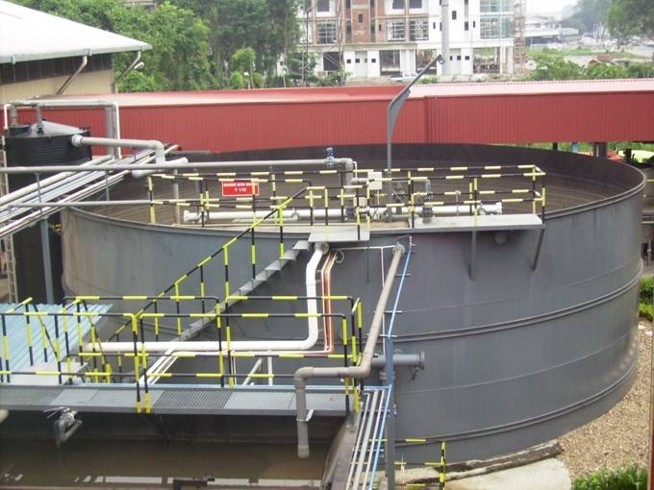
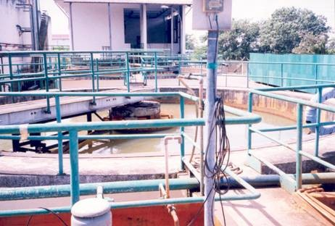
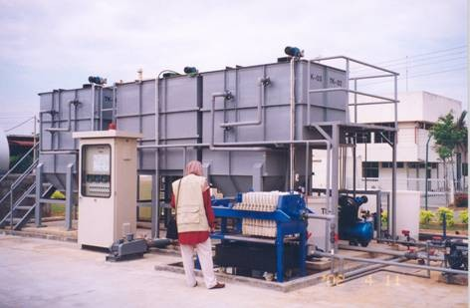
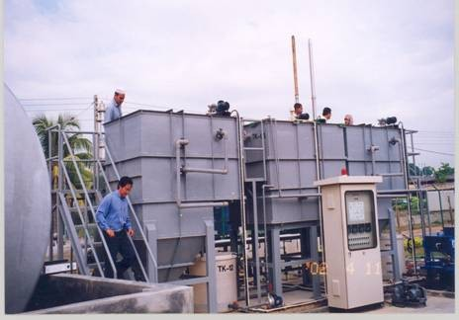
Sequential Batch Reactor
Industrial Effluent Treatment Systems

Slide 9

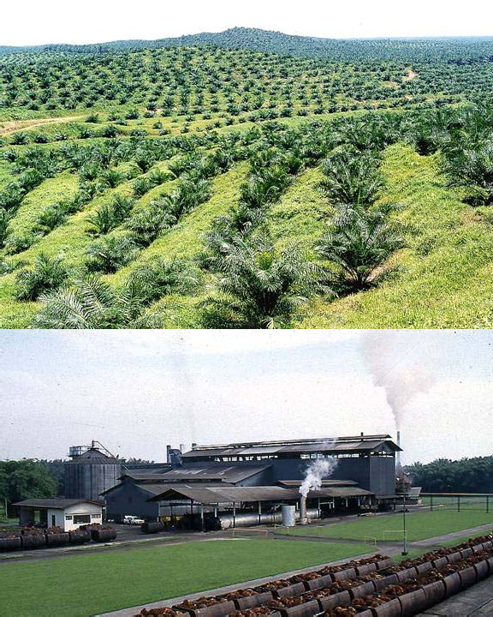
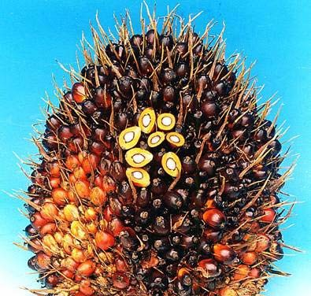
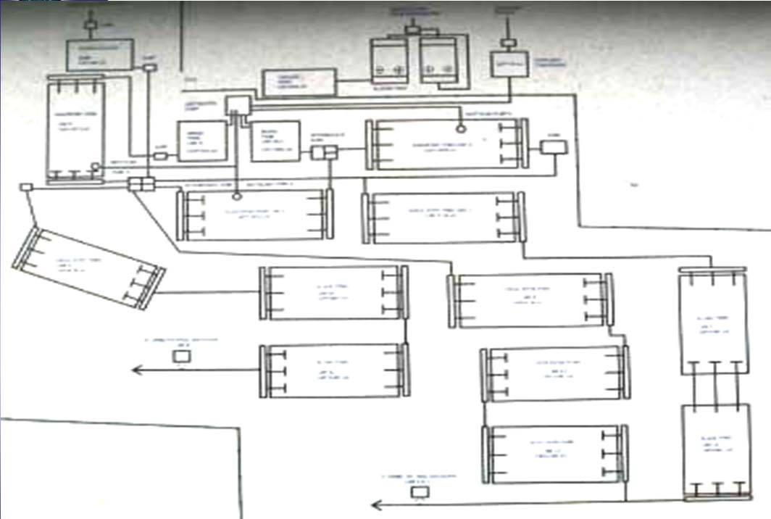
Facultative Pond
Oil trap
Anaerobic pond B
Cooling pond
Mixing pond
Anaerobic pond C
Facultative pond C
Facultative pond B
Facultative pond B
Facultative pond A
Facultative pond C
Final discharge B
Algae pond B
Facultative pond A
Final discharge A & B
Algae pond A
Algae pond C

Slide 10
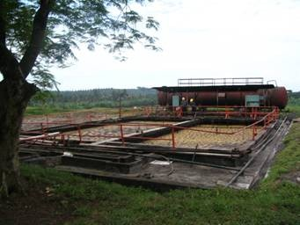
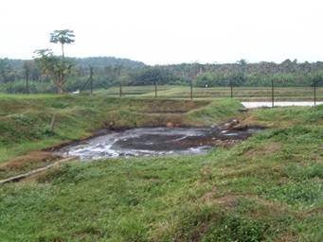
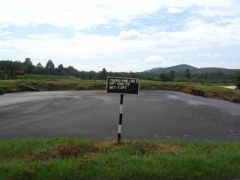
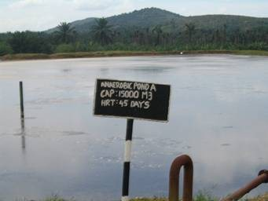
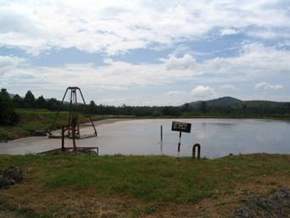
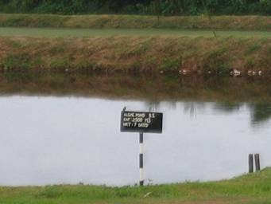
Engineering Design of IETS Ponding System
Oil trap
Cooling pond
Mixing pond
Anaerobic pond
Facultative pond
Algae pond

Slide 11
To monitor the quantity and quality of effluent discharged on a weekly basis
Relevant parameters are to be monitored based on guidance given in the Guidance Document on Performance Monitoring (GDPM)
On line the monthly discharge monitoring report (MDMR) needs to be submitted to DOE on a monthly basis
Discharge Monitoring
Section 7 IE2009
to operate and maintain the IETS in good working condition within the acceptable ranges/characteristics as specified in the Guidance Document on Performance Monitoring
Proper Operation of IETS
-Section 8 IE2009-

Slide 12
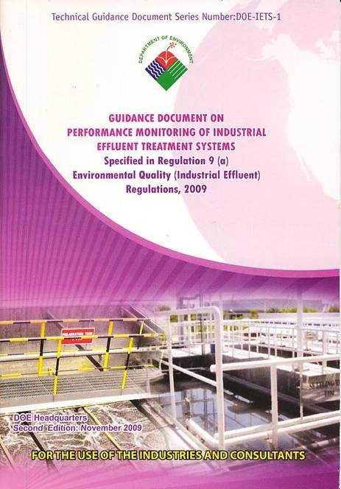
SECTION 9 IE2009
Operation of Industries and Performance Monitoring of IETS

Slide 13
Operation of Industrial Effluent Treatment Systems
WHAT IS PERFORMANCE MONITORING?
Handle proper operation and maintenance
Proactive & preventive monitoring of certain parameters to provide a diagnostic indication to ensure that each component of Industrial Effluent Treatment Systems are operating optimally.
Parameters to monitor our “health status”= “health of unit operations/processes” of IETS
Analytical Requirements
Performance monitoring is based on in- situ measurements using portable equipment or on-line sensors
Final effluent samples to follow Standard Methods

Slide 14
COMPETENT PERSON
Regulatory Requirements on Performance Monitoring (Section 10 IE2009)
The operation of an IETS needs to be supervised by a competent person (CP)
-any person who has been certified by the Director General
-on duty at any time of the IETS in operation
-monitor all components, unit processes/operations of the IETS
*[Nominated CP by premise needs to attend 10 days course program executed by EiMAS, practical training attachement and submission a project works before certified as CP by the GD of DOE]
Performance Monitoring of Biological Processes
3 different types of monitoring parameters:
to ensure biological process are functioning optimally e.g. pH, DO, and nutrients
to provide diagnostic check on the “health” status of various unit operations and unit processes e.g. MLSS & MLVSS, SVI
To indicate overall efficiency of the treatment system e.g. BOD & COD.

Slide 15
Dissolved Oxygen
DO concentration of about 1.5 to 4.0 mg/L; typically 2 mg/L
Insufficient oxygen promotes growth of filamentous organisms affecting sludge settleability
using a portable hand-held DO meter or measured continuously by on-line DO sensor
Sludge Volume Index SVI
SVI is used as an indication of settling characteristics of sludge and to determine recirculation ratio
Poor settling sludge results in a reduced BOD removal efficiency
SVI :<50 excellent,50-100 good,100-150 satisfactory, >150 very poor (bulking of sludge)

Slide 16
Nutrients
Many industrial effluents lack in nutrients Nutrient balance should be periodically checked The rule of thumb for BOD5: N: P ~ 100: 5: 1.
Typical signs of nutrient deficiency are filamentous growth and bulking of activated sludge.
Performance Monitoring of Physical and Chemical Processes
Heavy Metals Removal by Precipitation and Coagulation Reactions
Coagulation and precipitation reactions work best within narrow pH range
Solubility of metals is controlled by the solution pH where it is lowest at the point of minimum solubility
pH is the most useful parameter monitored

Slide 17
Performance Monitoring and Testing Guide for Biological Unit Processes
Activated Sludge
PH DO MLSS
MLVSS
OXYGEN UPTAKE NUTRIENTS
SVI
Daily Daily
Daily/weekly Weekly/monthly Weekly/monthly Weekly/monthly Weekly/monthly
PRACTICE OF PERFORMANCE MONITORING WILL…
Cultivate the maintenance culture Cultivate self monitoring & regulation
Ensure continued optimal performance (TIP- TOP) of IETS
Ensure continued regulatory compliance Help avoid IETS failure
Help avoid costly recovery action Help avoid regulatory enforcement

Slide 18
SECTION 15 IE2009
Contravention Licence
Polluter pay principle
Licence to pollute
New or Upgrading IETS
….last not least……IE2009
SECTION 32
………besides compound (RM 2000 each); conviction through court action carries a maximum penalty of RM100,000 PLUS 5 year jail……….

Slide 19
Thank You
Very Much

